Slide 1
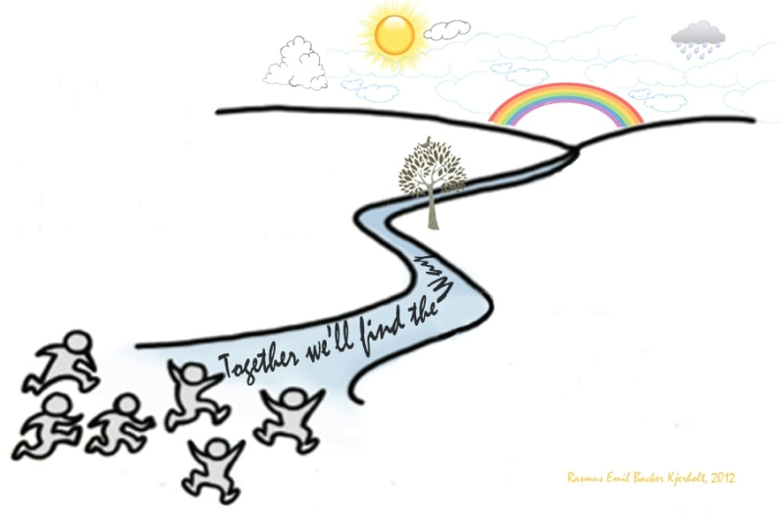

Mod!Kræft – an action research project focusing on development of young cancer patients` trajectories
Background:
In Denmark it is politically decided, that there must be targeted propositions for young people with cancer. Therefore Department of Hematology, Zealand University hospital, Denmark in 2017 initiated a combined development and research project, called
”Mod!Kræft”.
Results:
The methodology and methods have resulted in multi-faceted knowledge on young cancer patients` trajectories, and in individual and organizational learning.
The approach has during the one-year project-period resulted in 30 different actions on both a patient-oriented, health professional and organizational level, and thus the quality in the patient`s trajectories were developed at different levels.
Aim:
To develop the quality in young cancer patients´ trajectories by use of a personcentred and participatory approach.
Conclusion:
All the involved participants found the methodology and methods relevant og meaningful according to practice development, and the approach is now the prevailing approach in the Departments´ Unit for Nursing Research and Development.
Methods:
A qualitative action research project with a personcentred approach. The research design and approach was chosen based on the assumption that the approach would ensure that the project and the initiatives and actions taken would be experienced relevant and meaningful for the participants, and give them an important voice from start to end of the project. Therefore, from the start of the project a youth panel was established so the young throughout the project had a decisive influence on what actions to be taken to develop the quality in their trajectories.
The methods used during the whole project-period were scheduled meetings and informal/ad hoc dialogues between all participants (young cancer-patients, nurses and doctors), and logs from the participants.
Together we will find the way
Mette Buur Bergmann, Nurse, Youth Coordinator
Mette Kjerholt, Nurse, Reserch Leader
Tina Lanther, Head Nurse
Kristina Work, Clinical Nursespecialist, Youth ambassador
Charlotte Berggreen Smidt, Nurse, coordinator
Maria Torp Larsen, MD

