Slide 1
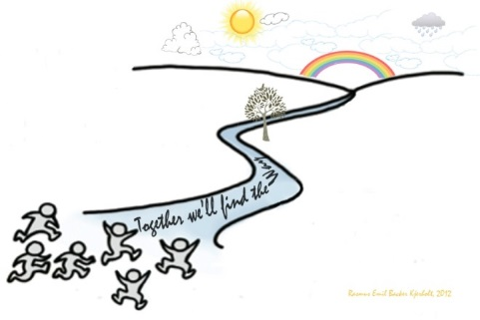

Back on Track, Nursing Empowerment Culture in a Danish University Hospital Department
Britta Louise Schack, Mia Skoropa Markschat, Anne Struer & Mette Kjerholt
Department of Hematology, Zealand University Hospital Denmark
Due to increase of more patients, but without additional nursing ressources led to nursing staff becoming burned out, long-term sick leave, frustration, resignment.
The department’s action-learning and person-centred culture regarding leadership and practice development could not be practiced due to the urgent need for the nursing staff to “put out fires” in clinical practice.
Therefore the department’s ward nurse, assistant ward manager and clinical nurse specialist sought support to get back on track according to a person-centred culture.
Meetings held twice a month for 2 years. Each lasting 1½ hours facilitating by a skilled nurse and based on the following questions:
How can we get back on track?
  How can we strengthen each other while we also strengthening our department’s?
  What matters to us?
  What do we do that doesn’t make sense and could perhaps stop or pause?
  The department’s dream needs to wake up and live again, how do we achieve that?
BACK ON TRACK
The overall result of the facilitated meetings was that they provide a safe space for brave conversations, leading to joint reflections and collective decision-making on future activities. The meetings also fostered a sense of belonging, community of practice and job satisfaction, as well as the opportunity for growth.
Introduction
Methods
Results/Conclusion
Continuous development and consolidation of action-learning and person-centred culture is an ongoing process that demands active and positive engagement from all healthcare staff, especially leaders and a supportive context.
Perspectives
Copyright © 2025 The authors, brls@regionsjaelland.dk

