Slide 1
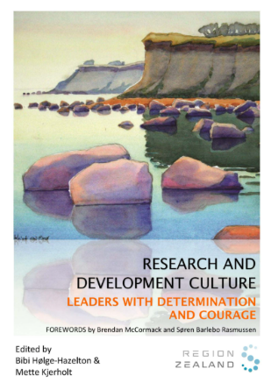



Enhancing Nursing Leaders’ Engagement and Capacity to Support Research and Development in Clinical Practice: A Decade of Capacity Building Experiences
Bibi Hølge-Hazelton ^{1,2} & Mette Kjerholt ³
¹⁾ Research Support Unit, Zealand University Hospital Denmark. ²) University of Southern Denmark, Department of Regional Research. ³⁾ Department of Hematology, Zealand University Hospital Denmark
At Zealand University Hospital (ZUH) in Denmark, a strategic goal for nursing and allied health professionals is to embrace evidence-based and person-centred practices. To achieve this ambition, leaders at all levels must serve as genuine role models.
Over the past decade, ZUH has developed tailored leadership support initiatives through close collaboration between leaders and senior researchers.
The initiatives are person-centred and its basic assumptions are that in order for organizational changes to occur, practice must be included in the overall process. Thus, action research, action learning and applied research runs as a red thread throughout all initiatives.
Nursing leaders at all levels across ZUH have gained more knowledge, courage and competences and have demonstrated willingness and ability to support a research and development culture in almost all clinical departments.
Introduction
1:It is necessary to have skilled, person-centered facilitators to support leaders' competence development in clinical research and development.
2: Special attention to mid-level leaders is essential, as this group is particularly under pressure due to constant changes and demands in the healthcare sector.
Some of the efforts are documented in the book ‘Leaders with Determination and Courage,’ where leaders across the spectrum share their experiences in supporting practice development. Originally published in Danish, the book has also been translated into English.
Results
Journal Clubs, Writing Opportunities, Action Learning Sets, Person Centred Leadership Course, National Conferences.
Leadership initiatives
Copyright © 2025 The authors, bibh@regionsjaelland.dk

